Slide 1

MANUFACTURING INFORMATION SYSTEMS
Support the production/ Operations Functions that include all activities.
Activities concerned with the planning and control of process producing goods and services.
Firms such as transportation companies, Whole sales, Retailers, Financial and Service companies use IS.

Slide 2
MANUFACTURING INFORMATION SYSTEM
Manufacturing Resource Planning System
Manufacturing Evaluation System
Engineering System
Production Forecasting
Shop Floor Scheduling
Computer Aided Design
Production Scheduling
Shop Floor Control
Computer Aided Engineering
Material Requirements Planning
Machine Control
Computer Aided Planning
Capacity Planning
Robotics Control
Production Cost Control
Products Simulation and Prototyping
Process Control
Quality Control
Computer – Integrated Manufacturing (CIM)

Slide 3
COMPUTER INTEGRATED MANUFACTURING (CIM)
Variety of manufacturing IS support CIM.
Overall Concept that stresses the following Objectives
  Simplify ( Reengineer Production Process)
  Automate ( Production Process)
  Integrate (Production and support Process
The overall goal of CIM and MIS is to create Flexible, agile manufacturing process that produce products of high quality.
CIM Supports Flexible manufacturing system (FMS), Total Quality Management (TQM).

Slide 4
BENEFITS OF CIM
Flexible production Process.
High Quality Products.
Work Simplification, Automation and Integration.
Improved Utilization of Production Facilities.
Higher Productivity and Better Quality Control from Feedback.
Reduced investments in inventories.
Customer Satisfaction by reducing Out-of-Stock operations.

Slide 5
ENGINEERING SYSTEMS
Engineers use Computers to design better Products using
  Computer Aided Engineering (CAE)
  Computer Aided Design (CAD)
To Design the better production process, they use Computer Aided Process Planning.

Slide 6
COLLABORATIVE MANUFACTURING NETWORKS
Using the internet, intranet, Extranet and other networks to link the work stations of Engineers with their colleagues at other site.
Also link the employees within company and customers or suppliers where they may be located.
For Example, Automotive systems Groups is linked with Ford.
The engineers uses the Computer network to discuss on car seat design, production issues and delivery schedules.

Slide 7
MANUFACTURING EXECUTION SYSTEMS (MES)
Performance monitoring information systems for factory floor operations.
They monitor, track and control 5 Essential Components viz.,
  Materials
  Equipments
  Personnel
  Instructions and specifications
  Production facilities
MES also includes
  Shop floor scheduling
  Shop floor control
  Machine control
  Robotics control
  Process Control

Slide 8
PROCESS CONTROL
Use of computers to control an ongoing physical process
Process control computers control physical process in petroleum refineries, cement plants, Steel plants, Chemical plants, Pulp and Paper mills and Electric power plants.
Special purpose microcomputer systems
Requires Special sensing devices
The devices measures physical phenomenon such as temperature or pressure.
These measurements are converted into digital forms by converters.
Process control Software is used to analyze the data generated by physical process.
The results are compared with standards.
Periodic and Demand reports are produced.

Slide 9
MACHINE CONTROL
Use of Computers to control the activities of a machine (Numeric Control)
Numeric control programs convert engineering drawings and machining instructions into numeric code of commands.
Involves use of special purpose micro computers called “Programmable Logic Controllers” (PLC).
PLC operates one or more machines according to the directions of numeric control program.
Specially equipped PC’s are used to develop and install Numeric Control program in PLC.
Fine-Tune machine tool performance.

Slide 10
ROBOTICS
Development in machine control.
Creation of smart machines and robots.
These devices directly control their own activities with the aid of computers.
Robotics is the technology of building and using machines (Robots).
Computer Intelligence, Computers-Controlled human like capabilities like movement and vision.
Robots are “Steel Collared Workers”.
Increase Productivity and cut Costs.

Slide 11
For example, a robot can assemble compressor valves with 12 parts a the rate of 320 units per hour, which is 10 times the rate of human workers.
Used in hazardous areas.
Robots follow the programs given by the server.
Input is received from visual/tactile sensors, processed by micro computers and translated into movements of the robots.
For example, movement of hands to pick up and land items.

Slide 12
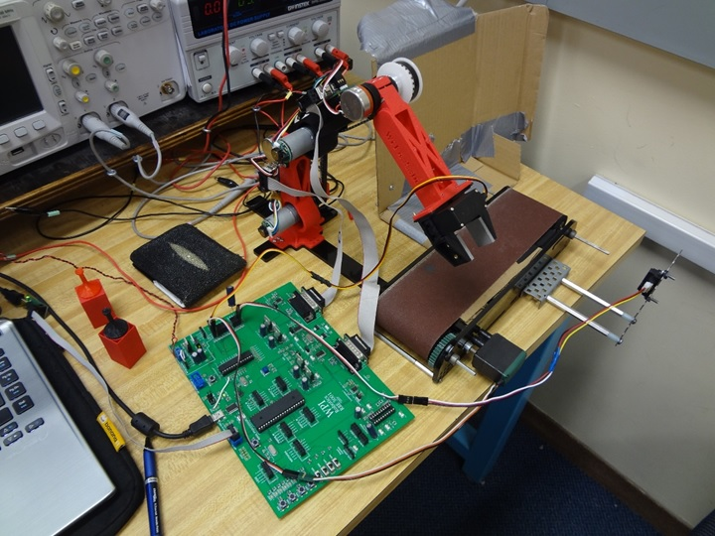
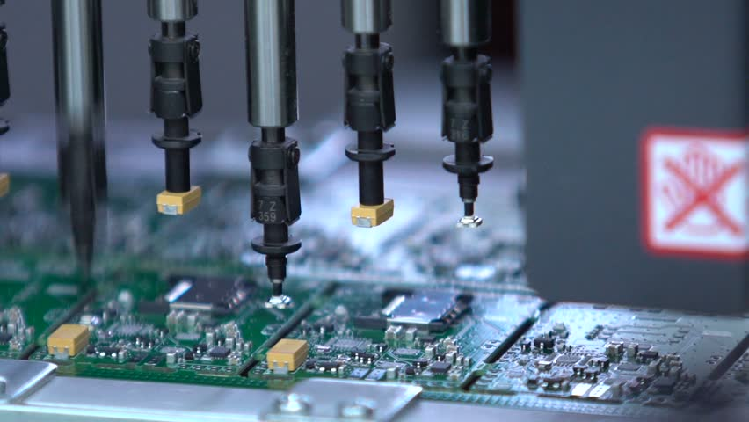
Images of Robotics Control

Slide 13
MANUFACTURING RESOURCE PLANNING
The planning of types of materials needed in production process is called “ Material Resource Planning” (MRP).
Integrating MRP with production scheduling, shop floor operations is known as “Manufacturing Resource Planning”.
COMPUTER-AIDED MANUFACTURING
Systems that automate production process.
This could be accomplished by/through MES

